Slide 1
FOSFOR CODE-A-THON
Frontend Development

Slide 2
Technology Used
React Js
Material UI
VS Code
Javascript

Slide 3
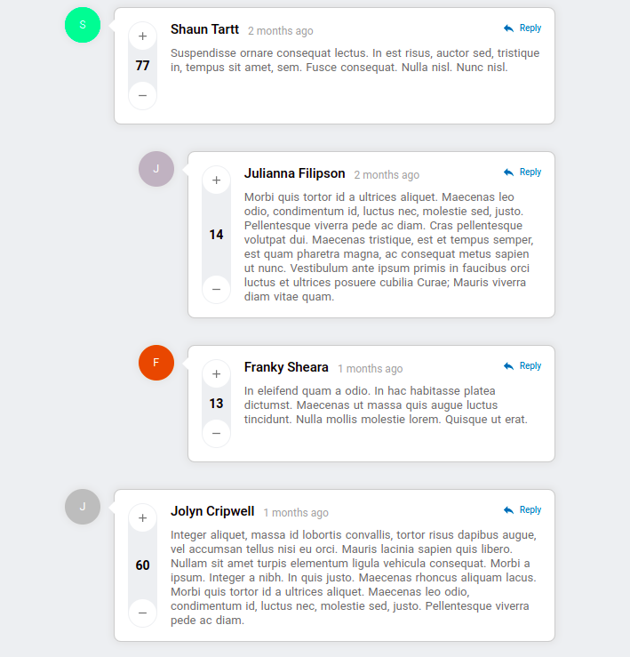
High Level Architecture
COMMENTS
Id
Src
Fullname
Comment
Created_time
Upvote
downvote
Id
Src
Fullname
Comment
Created_time
Upvote
downvote
(Score = upvote - downvote)
Id
Src
Fullname
Comment
Created_time
Upvote
downvote
(Score = upvote - downvote)

Slide 4
Flow Chart
Sorting first level comments
Score = Upvote - downvote
JSON data
Result
Sorting second level comments
Comment time = current - posting time
Add Reply
Get current comment Id -> Append the last comment
Result
Remove a comment
Get current comment Id -> filter it out
Result

